Slide 1


Battery Degradation Prediction Using Machine Learning
Battery storage
ESL 7673
PRESENTED BY:
SARINA UKE(2025ESZ7554)
ZEEL CHAUDHARI(2025ESY7614)
MOHD SUBHAN(2025ESZ8405)
RON LOCKER(2025ESR2915)
Notes:
Good morning everyone. Today, we are presenting our project on Battery Degradation Prediction Using Machine Learning.
This work focuses on understanding how batteries lose their performance over time and how we can predict this behavior using modern data-driven techniques.
I am Sarina Uke, and along with my team members, we will explain our approach, methodology, and key findings. Our goal is to show how machine learning can improve battery reliability and performance prediction.

Slide 2
TABLE OF CONTENT
Introduction
Objective
Battery degradation fundamentals
Methodology
Result and comparison
Conclusion and future scope
Problem statement
Notes:
This slide shows the overall structure of our presentation.
We will start with a basic introduction to batteries and the problem we are addressing. Then, we will discuss the objectives of our work and the fundamentals of battery degradation.
After that, we will explain our methodology, including data processing and machine learning models. Finally, we will present results, real-world applications, challenges, and conclude with future scope.

Slide 3
Introduction
Lithium-ion Batteries in Modern Technology
Backbone of modern technology
Widely used in:
Electric Vehicles (EVs)
Consumer Electronics
Renewable Energy Storage Systems
Aerospace & Medical Devices
Over time, batteries degrade:
Loss of capacity
Reduced power output
Predicting degradation is important for:
Safety
Cost optimization
Performance management
Sustainability
Traditional models are complex and computationally expensive
Machine Learning provides:
Data-driven
Accurate
Scalable solutions
Notes:
Lithium-ion batteries play a very important role in today’s world. They are used in electric vehicles, mobile phones, laptops, renewable energy storage systems, and even medical devices.
Because of their high energy density and efficiency, they have become the backbone of modern technology.
However, one major issue is that batteries do not last forever. With time and usage, they gradually lose their capacity and ability to deliver power, which is known as battery degradation.
Predicting battery degradation is very important for several reasons.
First, it ensures safety, as degraded batteries can lead to overheating or failure. Second, it helps reduce costs by optimizing battery replacement and maintenance schedules. Third, it improves performance by enabling better battery management strategies.
Traditional physics-based models are often complex and computationally expensive. In contrast, machine learning models can learn patterns directly from data, making them faster, scalable, and often more accurate.

Slide 4
Problem statement
Battery degradation: A complex challenge
Battery aging is non-linear and complex
Influenced by multiple factors:
Temperature
Charge/discharge rate
Depth of discharge
Cycling conditions
Current challenges:
Difficult to model using traditional methods
Degradation varies across batteries
Real-time monitoring is expensive
Early failure to prediction is difficult
Need:
Accurate and generalizable prediction model
Estimation of:
State of health (SOH)
Remaining useful life(RUL)
Use of Machine Learning approaches
Notes:
Battery degradation is a highly complex and nonlinear process.
It depends on multiple factors such as temperature, charging and discharging rates, depth of discharge, and operating conditions. Different batteries degrade differently even under similar conditions, making prediction more challenging.
Traditional modeling approaches struggle to capture this complexity. Also, real-time monitoring of battery health is expensive and difficult.
Therefore, there is a strong need for accurate and reliable models that can predict battery health and lifetime effectively.

Slide 5
Objective
Predict battery degradation over time
Estimate:
State of health(SOH)
Remaining useful life (RUL)
Identify key factors affecting battery degradation
Use Machine Learning models for accurate prediction
Compare model performance using evaluation metrics
Notes:
The main objective of our project is to predict how a battery degrades over time.
Specifically, we aim to estimate two important parameters: State of Health, which indicates the current condition of the battery, and Remaining Useful Life, which predicts how long the battery will last before failure.
We also aim to identify the key factors that influence degradation. Additionally, we compare different machine learning models to determine which gives the best prediction performance.

Slide 6
Battery degradation fundamentals
Gradual and irreversible loss of battery performance over time results in:
Capacity fade (reduced energy storage)
Power fade (increased internal resistance)
Types of aging
Calendar aging → occurs during storage (depends on temperature & SOC)
Cycle aging→ occurs during charge/discharge cycles
Key degradation mechanisms
SEI layer growth
Lithium plating
Loss of active material
Electrolyte decomposition
Battery health indicators
SOH =(current capacity / rated capacity) * 100%
RUL → Remaining cycles before failure
Key parameters:
Derived features:
ΔV, incremental capacity, capacity fade rate
(80% → end of life)
Voltage, current, temperature, capacity
Notes:
Battery degradation refers to the gradual and irreversible loss of battery performance over time.
This mainly includes capacity fade, which means reduced energy storage, and power fade, which means increased internal resistance.
There are two main types of aging: Calendar aging, which occurs when the battery is stored, and Cycle aging, which occurs during repeated charging and discharging.
Several internal mechanisms cause degradation, such as SEI layer growth, lithium plating, and loss of active material.
To measure battery health, we use indicators like State of Health (SOH) and Remaining Useful Life (RUL). These parameters are essential for predicting battery performance and ensuring reliable operation.

Slide 7
Dataset
NASA battery dataset (PCoE)
34 Li-ion cells (18650)
Charge, discharge, impedance
Run to failure experiments
Ambient temperature: 24C, 43C
~170 cycles per cell
CALCE battery dataset
CS2 series cell
Multiple cycling profiles
500+ cycles
Data structure:
Each cycle contains:
Volatage measured
Current measured
Temperature measured
Current charge
Volatge charge
Time
Capacity

Slide 8
Methodology
Workflow:
Data collection: battery cycling datasets used for analysis
Data preprocessing: includes preprocessing and feature engineering
Model development: application of ML models (Regression, LSTM, SVM)
Model evaluation: performance comparison using standard metrics
Prediction: estimation of SOH& RUL
Approach
Use data-driven Machine Learning models
Input: battery parameters
Output: SOH, RUL

Slide 9
Data Preprocessing and feature engineering
Data preprocessing
Remove incomplete data and outliers
Handle missing values (interpolation)
Normalize data (min-max / standard scaling)
Train-test split (70-80% /20-30%)
Feature extraction
Extract cycle-based features:
Voltage (max, min, ΔV)
Capacity (charge/discharge, fade)
Temperature (mean, variation)
Time (charge/discharge duration)
Internal resistance

Slide 10
Machine Learning models
Linear regression
Simple, interpretable
Assumes linear relationship
Random forest
Ensemble of decision trees
Handles non-linearity well
Feature importance ranking
Support vector machine (SVM)
Kernel trick for non-linearity
Good for small datasets
Gradient boosting (XGBOOST)
State of the art for tabular data
Regularization prevents overfitting
Fast and scalable
Long Short-Term Memory(LSTM)
Deep learning for sequential data
Captures long-term dependencies
Ideal for time-series battery data

Slide 11
Result and comparison
MODEL | RMSE | MAE | R² | MAPE%
Linear Regression | 0.0512 | 0.0401 | 0.891 | 3.82%
SVR (RBF) | 0.0345 | 0.0278 | 0.934 | 2.61%
Random Forest | 0.0198 | 0.0156 | 0.971 | 1.45%
XGBoost | 0.0152 | 0.0121 | 0.982 | 1.12%
LSTM | 0.0098 | 0.0076 | 0.993 | 0.71%

Slide 12
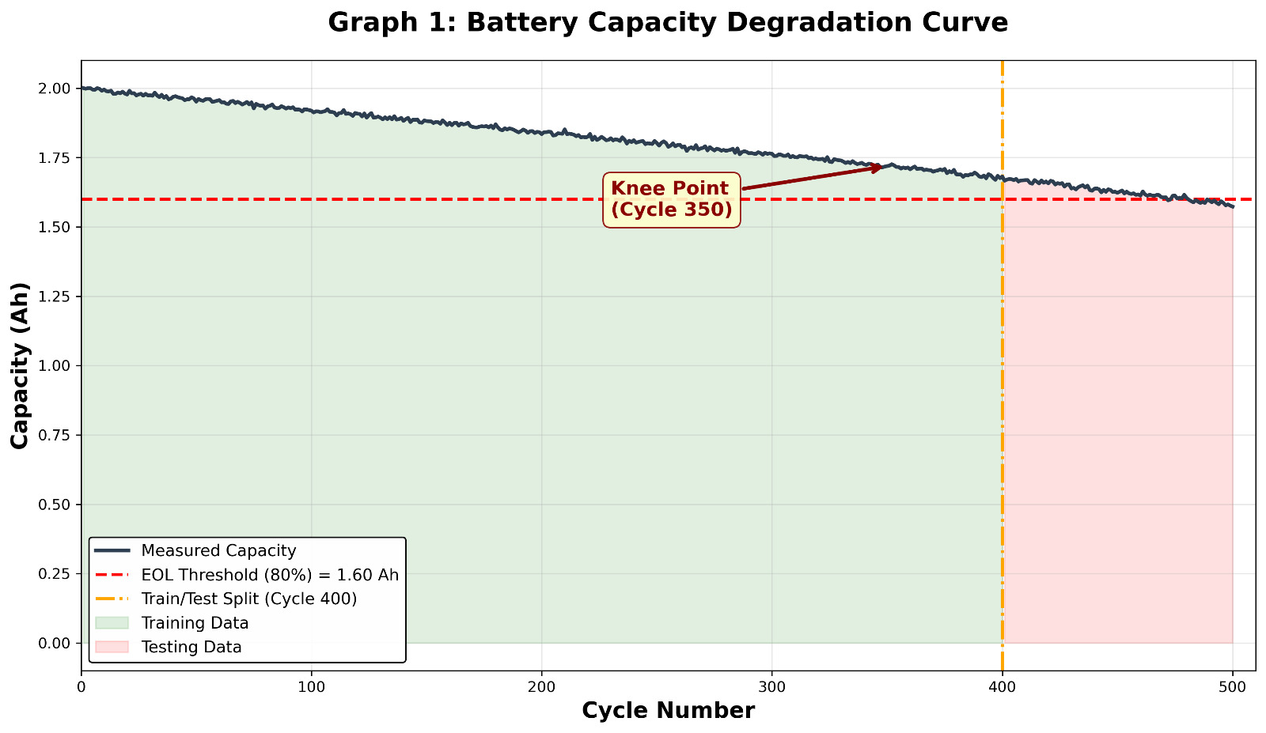
Gradual decrease in battery capacity with increasing charge-discharge cycles.
A knee point (~cycle 350) is observed, after which degradation accelerates significantly.
The End-of-Life (EOL) threshold is defined at 80% capacity (~1.6 Ah).
Data is divided into:
Training region (before cycle 400)
Testing region (after cycle 400)
This trend highlights the nonlinear aging behavior of batteries, which is critical for predictive modeling.

Slide 13
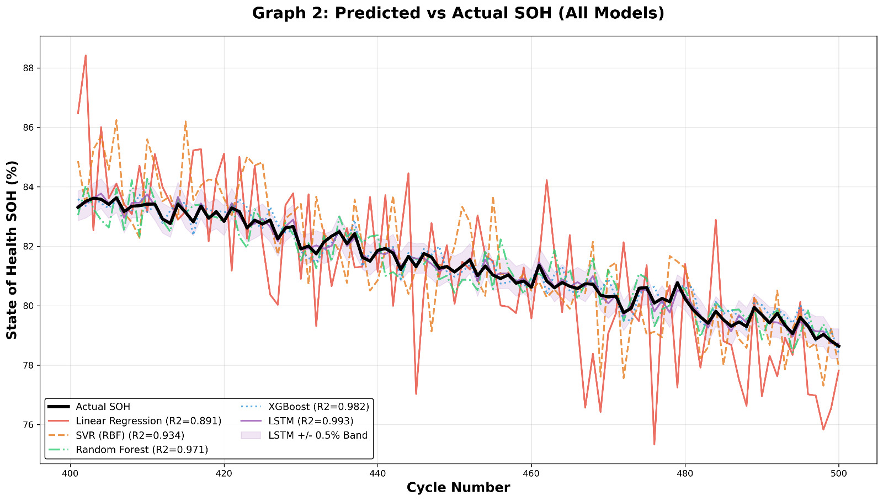
This graph compares actual State of Health (SOH) with predictions from multiple ML models.
Models such as XGBoost and LSTM closely follow the actual degradation trend, showing high accuracy.
Traditional models like Linear Regression show larger deviations, especially during rapid degradation phases.
The results demonstrate that nonlinear and temporal models perform better for battery degradation prediction.

Slide 14
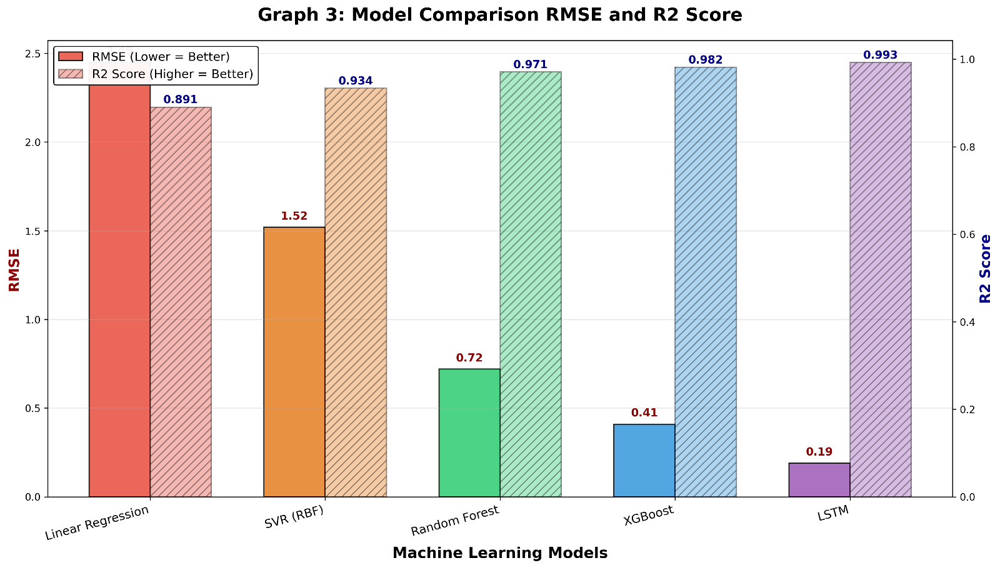
Performance of different models is evaluated using:
RMSE (lower is better)
R² Score (higher is better)
LSTM achieves the best performance with:
Lowest RMSE (~0.19)
Highest R² (~0.993)
XGBoost and Random Forest also show strong performance.
Linear Regression performs worst, indicating inability to capture nonlinear degradation.
This confirms that advanced ML models are more suitable for SOH prediction.

Slide 15
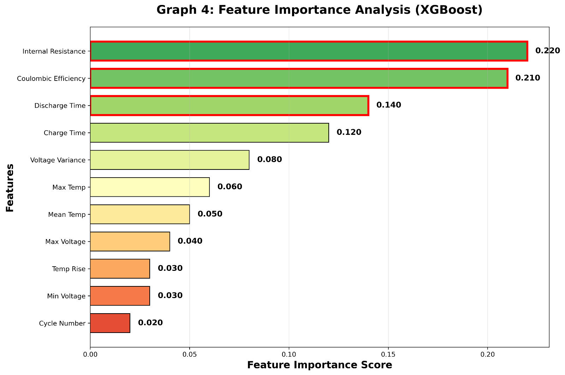
The model identifies key factors affecting battery degradation:
Internal Resistance (most important)
Coulombic Efficiency
Discharge Time & Charge Time
Temperature and voltage-related features have moderate impact.
Cycle number has relatively lower importance when other features are included.
This analysis helps in understanding physical drivers of battery aging.

Slide 16
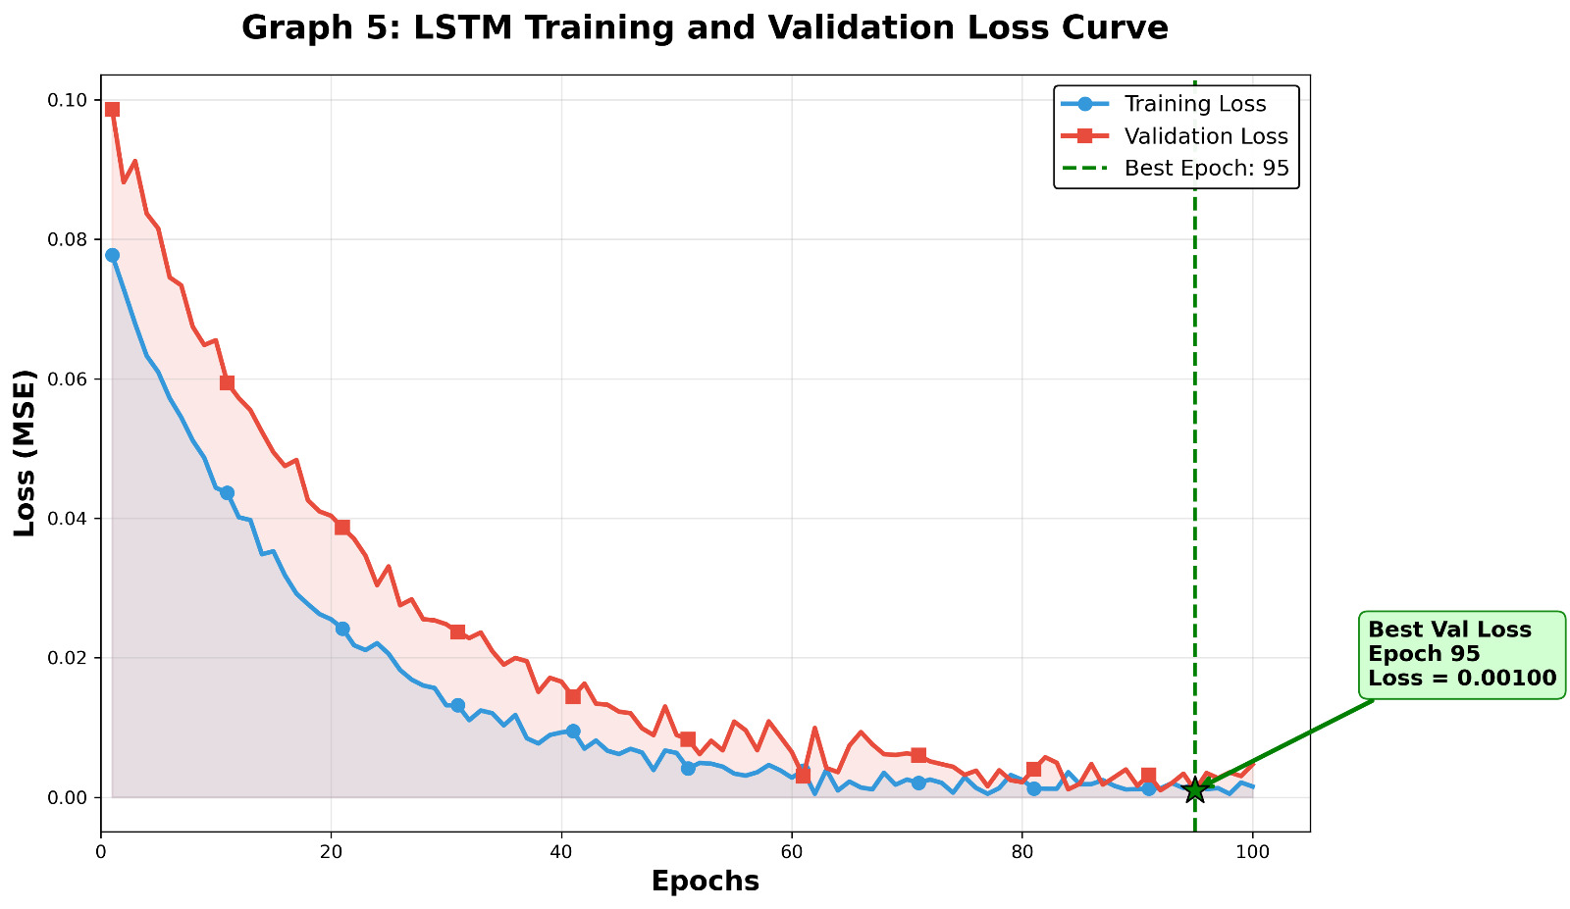
The graph shows training and validation loss decreasing over epochs, indicating effective learning.
Both curves converge smoothly, suggesting minimal overfitting.
The best model is achieved around epoch ~95 with lowest validation loss.
This demonstrates that the LSTM model is well-optimized and stable.

Slide 17
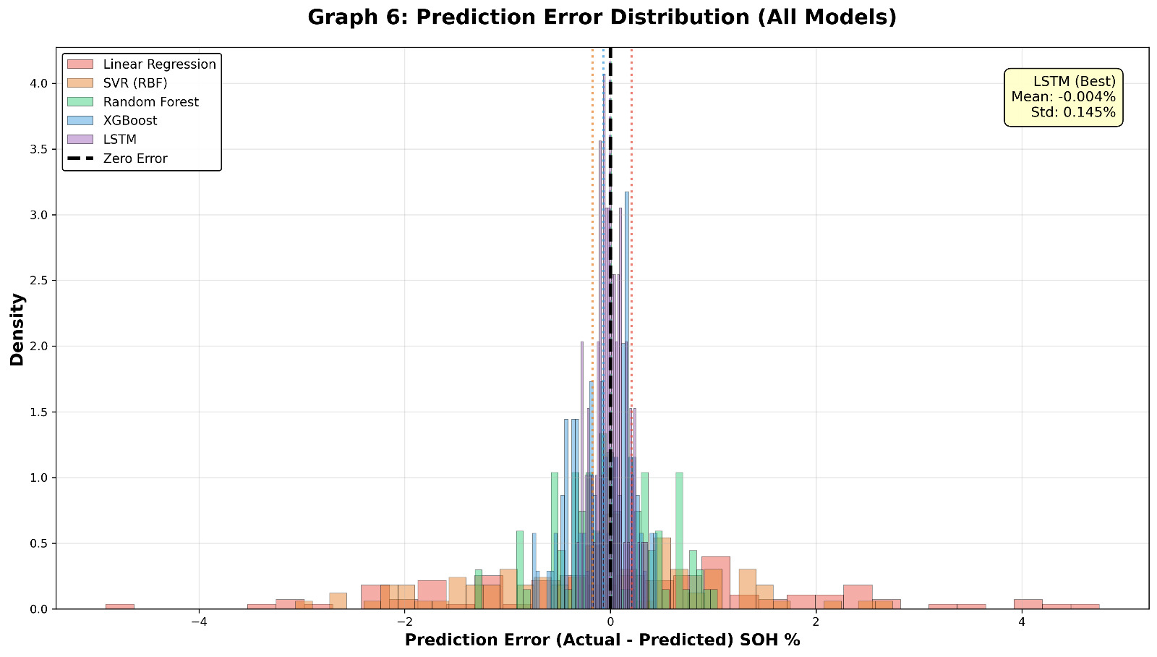
This histogram shows the distribution of prediction errors (Actual – Predicted SOH).
Errors are centered around zero, indicating unbiased predictions.
LSTM has the narrowest distribution, meaning highest precision.
Other models show wider spreads, indicating higher uncertainty.
This confirms that LSTM provides the most reliable predictions.

Slide 18
Real world applications
Electric vehicles
Tesla, BYD use ML in Better Management System
Predict range degradation over years
Optimize charging strategies
Grid scale energy storage
Predict when to replace battery packs
Optimize dispatch schedules
Reduce operational costs
Consumer electronics
iPhone battery health features
Laptop battery wear estimation
Medical devices
Pacemakers, portable monitors
Critical reliability requirements
Aerospace and defense
Satellite battery management
UAV mission planning

Slide 19
Challenges and limitations
Data scarcity
Battery testing is time consuming
Limited publicly available run to failure dataset
Generalizability
Models trained on one chemistry may not work for others
Operating conditions vary widely
Non-stationarity
Degradation patterns change over battery lifetime
Knee point- sudden capacity drop is hard to predict
Computational cost
Deep learning models require significant compute for training
Real time deployment
Edge devices have limited memory/processing
Model compressing needed
Interpretability
Black box model are hard to trust in safety critical application

Slide 20
Conclusion and future scope
Conclusion
ML models accurately predict SOH & RUL
Battery degradation prediction improves safety, cost and performance
LSTM performs best for time-series data
XGBoost is the best among traditional ML models
Feature engineering plays a crucial role
Future scope
Transfer learning → reduces data requirements
Physics informed ML→ hybrid modeling approach
Transformer models → advanced sequencing prediction
Federated learning → privacy preserving training
Real time deployment in battery Management Systems

Slide 21
References
Severson, K. A., et al. "Data-driven prediction of battery cycle life before capacity degradation."Nature Energy, 4(5), 383-391, 2019.
Saha, B. & Goebel, K. "Battery data set."NASA Prognostics Data Repository, 2007.
Zhang, Y., et al. "Long short-term memory recurrent neural network for remaining useful life prediction of lithium-ion batteries." IEEE Trans., 2018.
Richardson, R. R., et al. "Gaussian process regression for forecasting battery state of health." Journal of Power Sources, 357, 209-219, 2017.
Li, Y., et al. "Data-driven health estimation and lifetime prediction of lithium-ion batteries: A review." Renewable & Sustainable Energy Reviews, 2020.
Birkl, C. R., et al. "Degradation diagnostics for lithium-ion cells." Journal of Power Sources, 2017.
CALCE Battery Research Group, University of Maryland.

Slide 22
Thank you

